Slide 1
Drift Racind
Motivate to practice an extreme sport

Slide 2
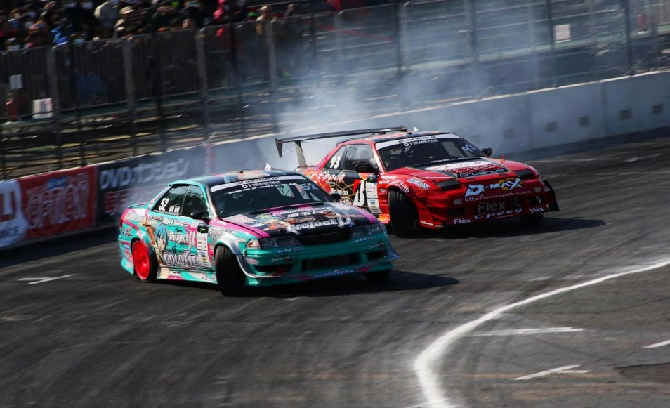
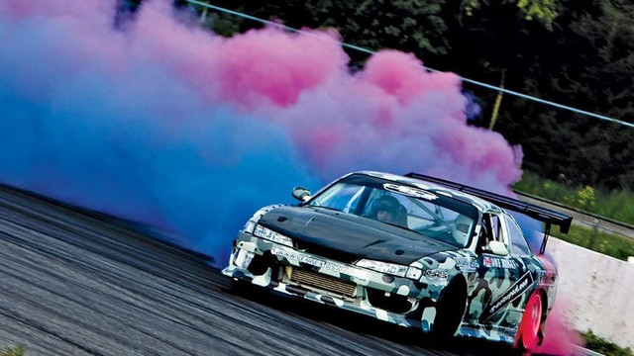
I chose this sport because I like cars. I like speed, adrenaline.

Slide 3
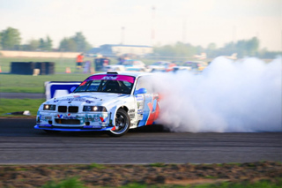
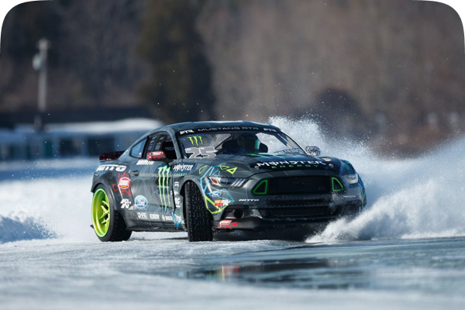
It is a turning technique and a type of motor sport.
The technique is controlled to the maximum, in order to maintain
the speed and the angle.
The competitions take place on dry asphalt, tracks with many turns
Only rear-wheel drive vehicles are used.

Slide 4
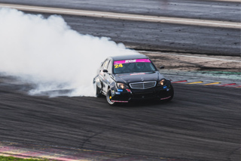
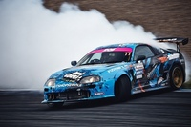
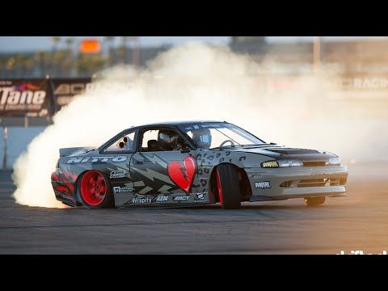
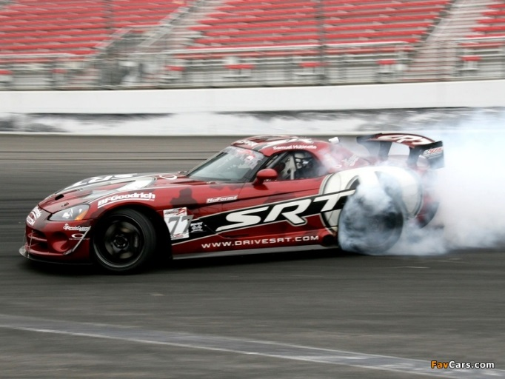
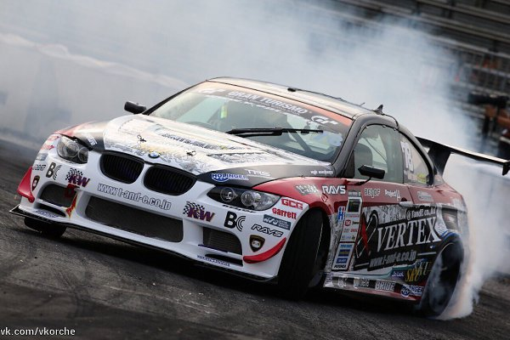
Some of the most used cars for these competitions are:
Mercedes-Benz
Tayota
Nissan
BMW
Dodge
Viper

